Slide 1
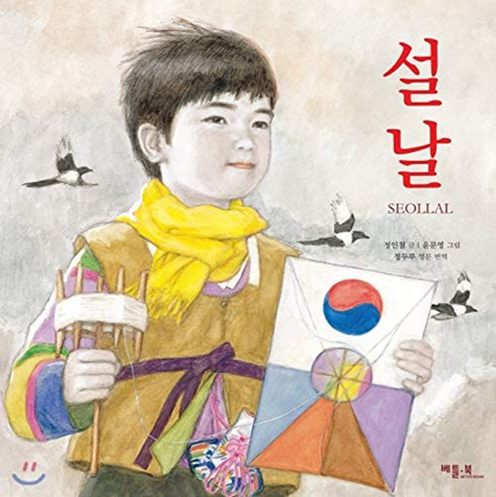
Seollal 설날 - Korean Lunar New Year

Slide 2
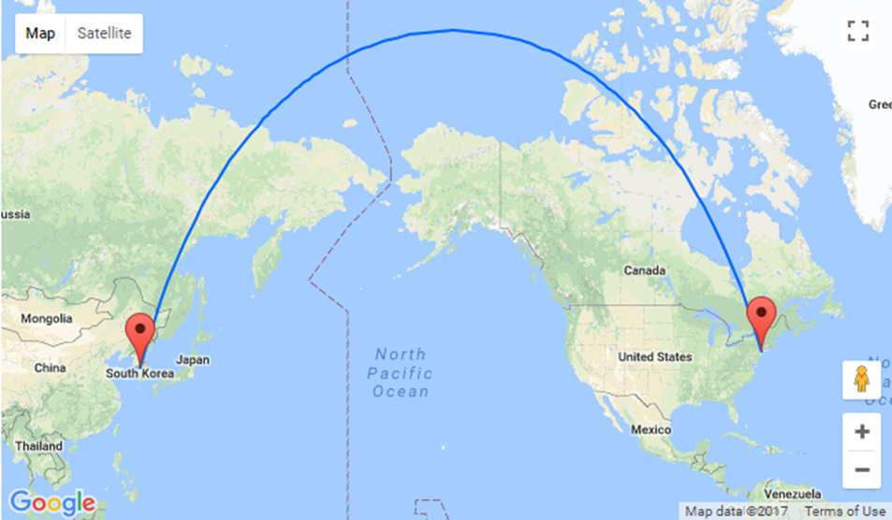
Korea?

Slide 3
How to say “Happy New Year”?

Slide 4
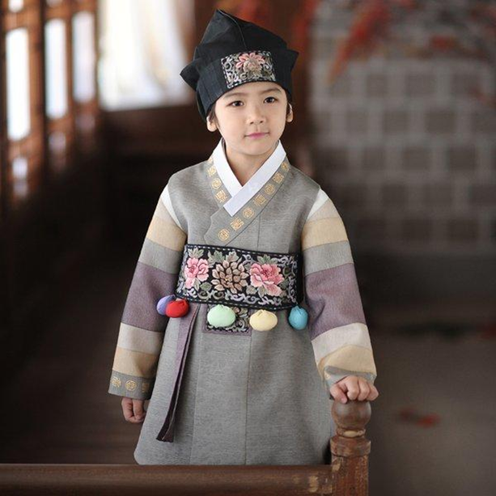
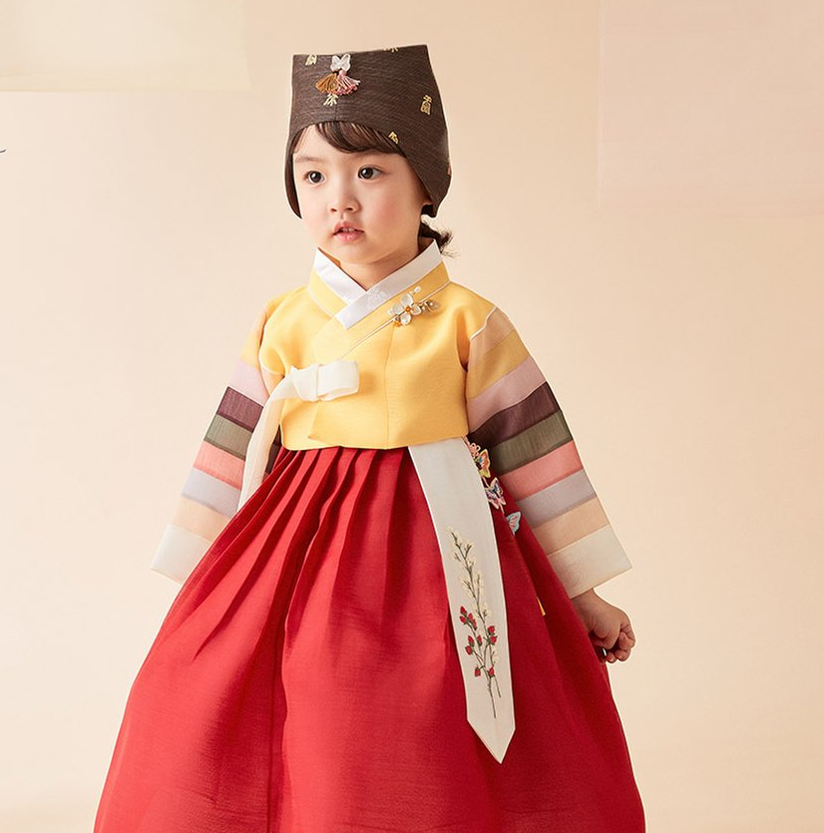
Seolbim 설빔 - New Year’s Outfits

Slide 5
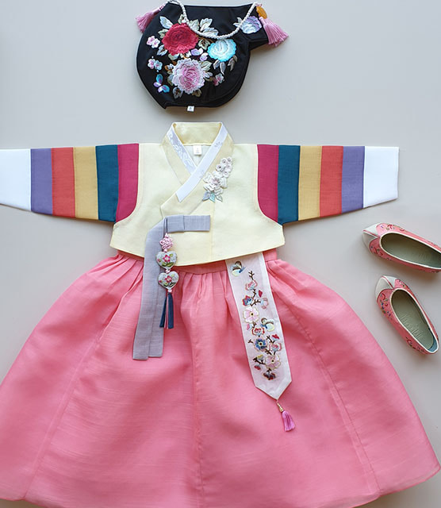
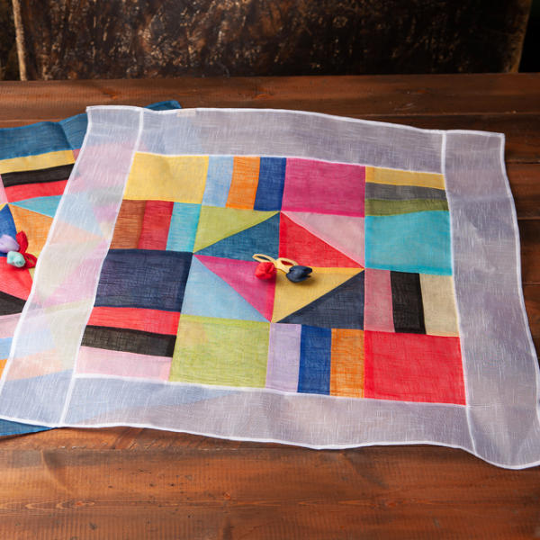
Saekdong 색동 - Korean Patchwork

Slide 6
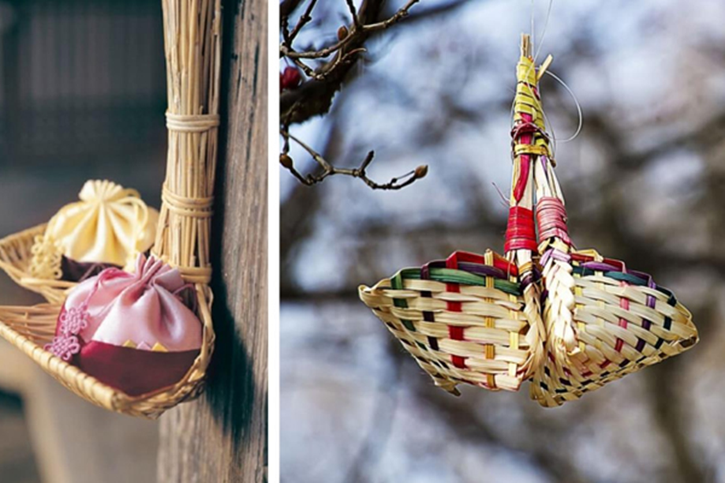
Bokjori 복조리 - Lucky Strainer

Slide 7
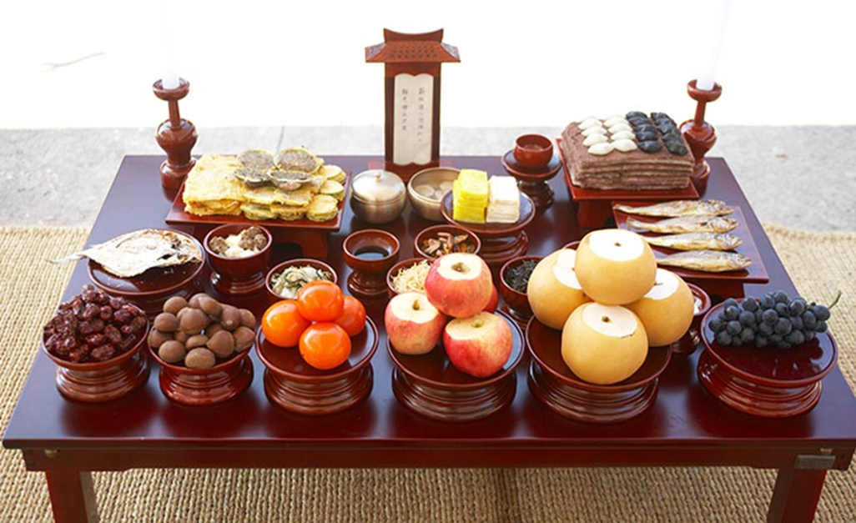
Charye 차례 - Memorial Service

Slide 8
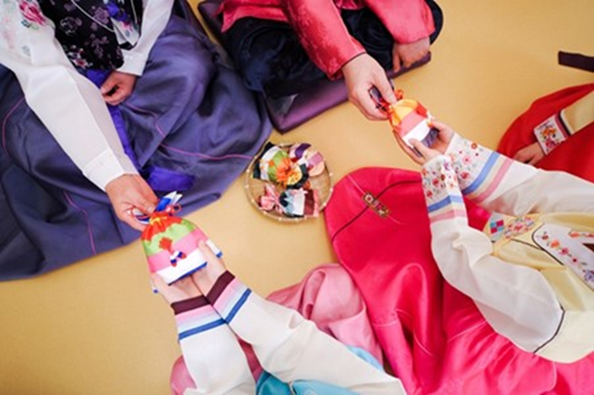
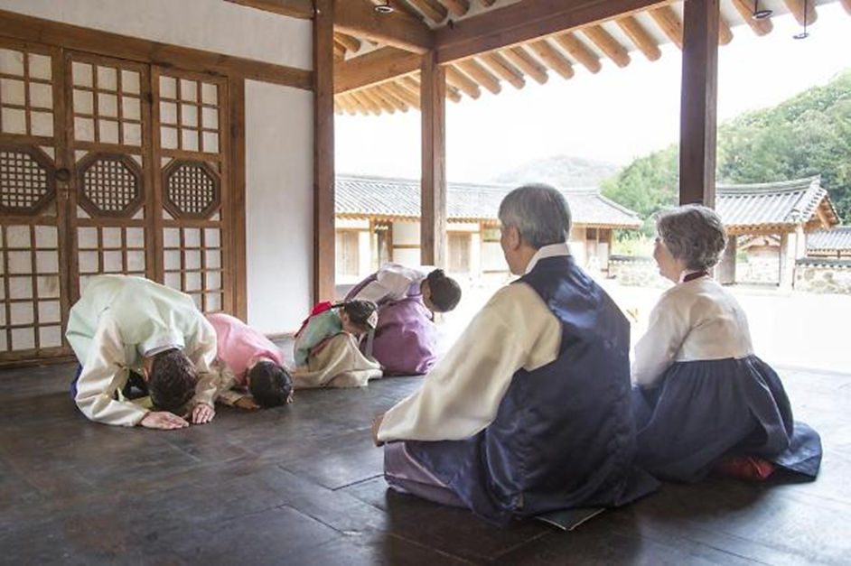
Sebae 세배 - Pay respect

Slide 9
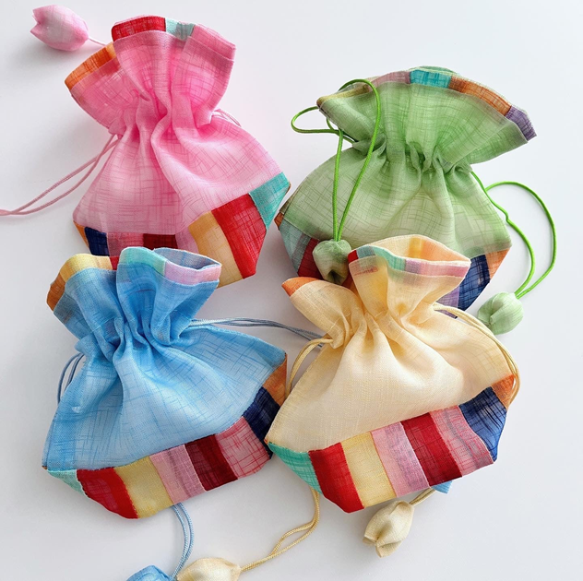
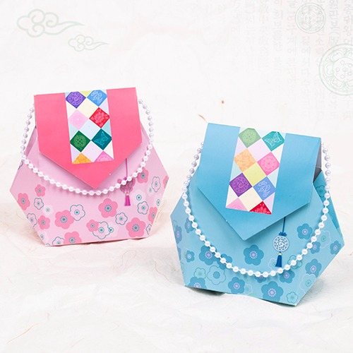
Bokjumoni 복주머니 - Lucky Bag

Slide 10
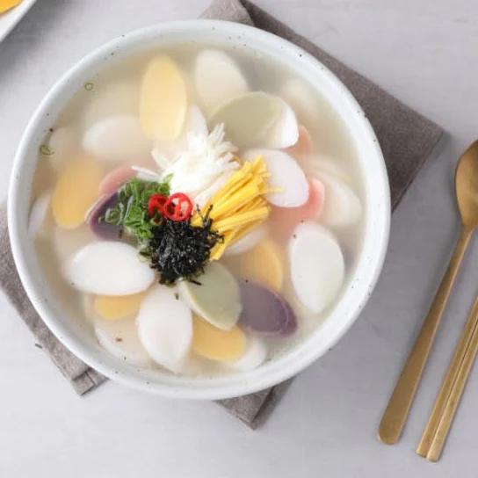
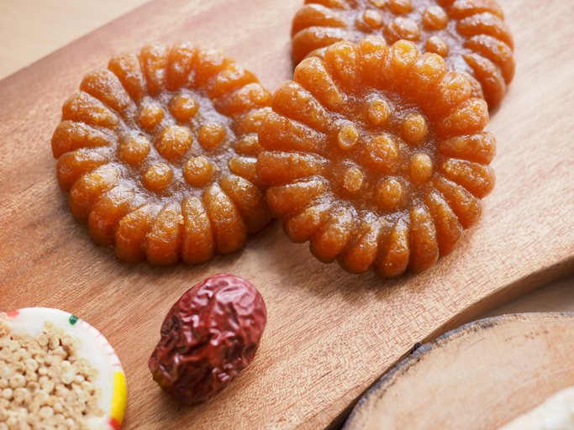
Ttokguk 떡국 Yakgwa 약과

Slide 11
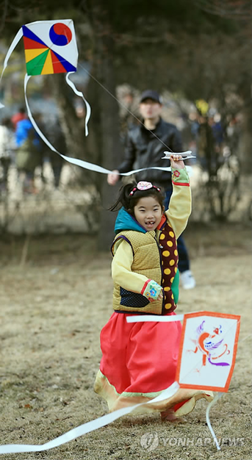
Bangpaeyon 방패연 - “Shield” Kite

Slide 12
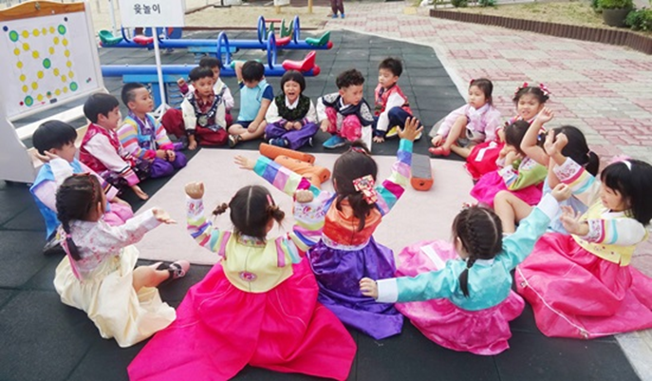
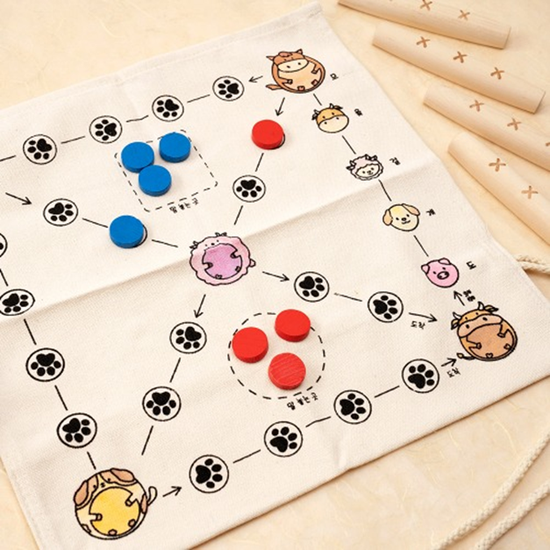
Yutnori 윷놀이 - Korean Board Game

